Slide 1
Data structures and algorithms Sorting Algorithms
Dr. Shams Qazi
shams.qazi@seecs.edu.pk

Slide 2
The Sorting Problem
Input:
A sequence of n numbers a₁, a₂, . . . , a_{n}
Output:
A permutation (reordering) a₁’, a₂’, . . . , a_{n}’ of the input sequence such that a₁’ ≤ a₂’ ≤ · · · ≤ a_{n}’

Slide 3
Structure of data

Slide 4
Why Study Sorting Algorithms?
There are a variety of situations that we can encounter
Do we have randomly ordered keys?
Are all keys distinct?
How large is the set of keys to be ordered?
Need guaranteed performance?
Various algorithms are better suited to some of these situations

Slide 5
Some Definitions
Internal Sort
The data to be sorted is all stored in the computer’s main memory.
External Sort
Some of the data to be sorted might be stored in some external, slower, device.
In Place Sort
The amount of extra space required to sort the data is constant with the input size.

Slide 6
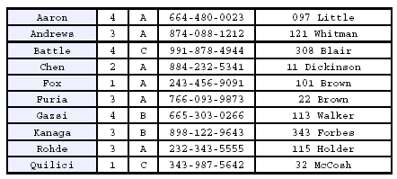
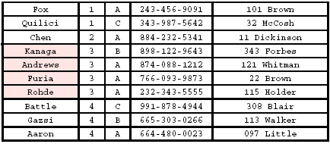
Stability
A STABLE sort preserves relative order of records with equal keys
Sorted on first key:
Sort file on second key:
Records with key value 3 are not in order on first key!!

Slide 7
Insertion Sort
Idea: like sorting a hand of playing cards
Start with an empty left hand and the cards facing down on the table.
Remove one card at a time from the table, and insert it into the correct position in the left hand
compare it with each of the cards already in the hand, from right to left
The cards held in the left hand are sorted
these cards were originally the top cards of the pile on the table

Slide 8
Insertion Sort
To insert 12, we need to make room for it by moving first 36 and then 24.
6
10
24
36
12

Slide 9
Insertion Sort
6
10
24
36
12

Slide 10
Insertion Sort
6
10
24
36
12

Slide 11
Insertion Sort
input array
5 2 4 6 1 3
at each iteration, the array is divided in two sub-arrays:
left sub-array
right sub-array
sorted
unsorted

Slide 12
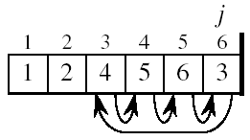
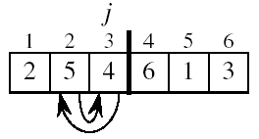
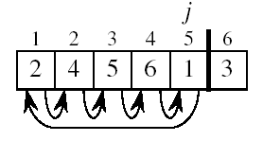
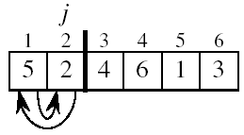
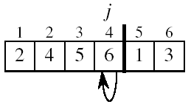
Insertion Sort

Slide 13
INSERTION-SORT
Alg.: INSERTION-SORT(A)
for j ← 2 to n
do key ← A[ j ]
Insert A[ j ] into the sorted sequence A[1 . . j -1]
i ← j - 1
while i > 0 and A[i] > key
do A[i + 1] ← A[i]
i ← i – 1
A[i + 1] ← key
Insertion sort – sorts the elements in place
1
2
3
4
5
6
7
8
a₁
a₂
a₃
a₄
a₅
a₆
a₇
a₈
key

Slide 14
Loop Invariant for Insertion Sort
Alg.: INSERTION-SORT(A)
for j ← 2 to n
do key ← A[ j ]
Insert A[ j ] into the sorted sequence A[1 . . j -1]
i ← j - 1
while i > 0 and A[i] > key
do A[i + 1] ← A[i]
i ← i – 1
A[i + 1] ← key
Invariant: at the start of the for loop the elements in A[1 . . j-1] are in sorted order

Slide 15
Proving Loop Invariants
Proving loop invariants works like induction
Initialization (base case):
It is true prior to the first iteration of the loop
Maintenance (inductive step):
If it is true before an iteration of the loop, it remains true before the next iteration
Termination:
When the loop terminates, the invariant gives us a useful property that helps show that the algorithm is correct
Stop the induction when the loop terminates

Slide 16
Loop Invariant for Insertion Sort
Initialization:
Just before the first iteration, j = 2:
the subarray A[1 . . j-1] = A[1], (the element originally in A[1]) – is sorted

Slide 17
Loop Invariant for Insertion Sort
Maintenance:
the while inner loop moves A[j -1], A[j -2], A[j -3], and so on, by one position to the right until the proper position for key (which has the value that started out in A[j]) is found
At that point, the value of key is placed into this position.

Slide 18

Loop Invariant for Insertion Sort
Termination:
The outer for loop ends when j = n + 1 ⇒ j-1 = n
Replace n with j-1 in the loop invariant:
the subarray A[1 . . n] consists of the elements originally in A[1 . . n], but in sorted order
The entire array is sorted!
j - 1
j
Invariant: at the start of the for loop the elements in A[1 . . j-1] are in sorted order

Slide 19
Analysis of Insertion Sort
INSERTION-SORT(A)
for j ← 2 to n
do key ← A[ j ]
Insert A[ j ] into the sorted sequence A[1 . . j -1]
i ← j - 1
while i > 0 and A[i] > key
do A[i + 1] ← A[i]
i ← i – 1
A[i + 1] ← key
cost times
c₁ n
c₂ n-1
0 n-1
c₄ n-1
c₅
c₆
c₇
c₈ n-1
t_{j}: # of times the while statement is executed at iteration j
Notes:
₇

Slide 20
Best Case Analysis
The array is already sorted
A[i] ≤ key upon the first time the while loop test is run (when i = j -1)
t_{j} = 1
T(n) = c₁n + c₂(n -1) + c₄(n -1) + c₅(n -1) + c₈(n-1) = (c₁ + c₂ + c₄ + c₅ + c₈)n + (c₂ + c₄ + c₅ + c₈)
= an + b = Θ(n)
“while i > 0 and A[i] > key”

Slide 21
Worst Case Analysis
The array is in reverse sorted order
Always A[i] > key in while loop test
Have to compare key with all elements to the left of the j-th position ⇒ compare with j-1 elements ⇒ t_{j} = j
a quadratic function of n
T(n) = Θ(n²) order of growth in n²
“while i > 0 and A[i] > key”
using
we have:
$$T(n)=c_{1}n+c_{2}(n−1)+c_{3}(n−1)+c_{4}(n−1)+c_{5}\left(\frac{n(n+1)}{2}−1\right)+c_{6}\frac{n(n−1)}{2}+c_{7}\frac{n(n−1)}{2}+c_{8}(n−1)$$
$$T(n)=c_{1}n+c_{2}(n−1)+c_{3}(n−1)+c_{4}(n−1)+c_{5}\sum_{j=2}^{n}{t_{j}}+c_{6}\sum_{j=2}^{n}{\left(t_{j}−1\right)}+c_{7}\sum_{j=2}^{n}{\left(t_{j}−1\right)}+c_{8}(n−1)$$

Slide 22
Comparisons and Exchanges in Insertion Sort
INSERTION-SORT(A)
for j ← 2 to n
do key ← A[ j ]
Insert A[ j ] into the sorted sequence A[1 . . j -1]
i ← j - 1
while i > 0 and A[i] > key
do A[i + 1] ← A[i]
i ← i – 1
A[i + 1] ← key
cost times
c₁ n
c₂ n-1
c₃ n-1
c₄ n-1
c₅
c₆
c₇
c₈ n-1
≈ n²/2 comparisons
≈ n²/2 exchanges

Slide 23
Insertion Sort - Summary
Advantages
Good running time for “almost sorted” arrays Θ(n)
Disadvantages
Θ(n²) running time in worst and average case
≈ n²/2 comparisons and exchanges

Slide 24
Bubble Sort
Idea:
Repeatedly pass through the array
Swaps adjacent elements that are out of order
Easier to implement, but slower than Insertion sort
i
1
2
3
n
8
4
6
9
2
3
1
j

Slide 25
Example
8
4
6
9
2
3
1
1
8
4
6
9
2
3
i = 1
j
i = 2
j
8
4
6
9
2
1
3
1
2
8
4
6
9
3
i = 1
j
i = 3
j
8
4
6
9
1
2
3
1
2
3
8
4
6
9
i = 1
j
i = 4
j
8
4
6
1
9
2
3
1
2
3
4
8
6
9
i = 1
j
i = 5
j
8
4
1
6
9
2
3
1
2
3
4
6
8
9
i = 1
j
i = 6
j
8
1
4
6
9
2
3
1
2
3
4
6
8
9
i = 1
j
i = 7
1
8
4
6
9
2
3
j
i = 1
j

Slide 26
Bubble Sort
Alg.: BUBBLESORT(A)
for i ← 1 to length[A]
do for j ← length[A] downto i + 1
do if A[j] < A[j -1]
then exchange A[j] ↔ A[j-1]
i
8
4
6
9
2
3
1
i = 1
j

Slide 27
Bubble-Sort Running Time
Alg.: BUBBLESORT(A)
for i ← 1 to length[A]
do for j ← length[A] downto i + 1
do if A[j] < A[j -1]
then exchange A[j] ↔ A[j-1]
c₁
c₂
Comparisons: ≈ n²/2
c₃
c₄
Exchanges: ≈ n²/2
T(n) =
c₁(n+1) +
c₂
c₃
c₄
= Θ(n) +
(c₂ + c₂ + c₄)
Thus,T(n) = Θ(n²)

Slide 28
Selection Sort

Slide 29
Selection Sort
Idea:
Find the smallest element in the array
Exchange it with the element in the first position
Find the second smallest element and exchange it with the element in the second position
Continue until the array is sorted
Disadvantage:
Running time depends only slightly on the amount of order in the file

Slide 30
Example
8
4
6
9
2
3
1
1
2
3
4
9
6
8
1
4
6
9
2
3
8
1
2
3
4
6
9
8
1
2
6
9
4
3
8
1
2
3
4
6
8
9
1
2
3
9
4
6
8
1
2
3
4
6
8
9

Slide 31
Selection Sort
Alg.: SELECTION-SORT(A)
n ← length[A]
for j ← 1 to n - 1
do smallest ← j
for i ← j + 1 to n
do if A[i] < A[smallest]
then smallest ← i
exchange A[j] ↔ A[smallest]
8
4
6
9
2
3
1

Slide 32
Analysis of Selection Sort
Alg.: SELECTION-SORT(A)
n ← length[A]
for j ← 1 to n - 1
do smallest ← j
for i ← j + 1 to n
do if A[i] < A[smallest]
then smallest ← i
exchange A[j] ↔ A[smallest]
cost times
c₁ 1
c₂ n
c₃ n-1
c₄
c₅
c₆
c₇ n-1
n²/2
comparisons
n
exchanges

Slide 33
Merge Sort

Slide 34
Divide and Conquer
Divide the problem into a number of sub-problems
Conquer the sub-problems by solving them recursively
Base case:
If the sub-problems are small enough,
solve them directly in constant time.
Combine the sub-problem solutions to give
a solution to the original problem

Slide 35
Mergesort
void mergesort(int theArray[], int first, int last) {
if (first < last) {
int mid = (first + last)/2; // index of midpoint
mergesort(theArray, first, mid);
mergesort(theArray, mid+1, last);
// merge the two halves
merge(theArray, first, mid, last);
}
} // end merge sort

Slide 36
Merge
const int MAX_SIZE = N
void merge(int theArray[], int first, int mid, int last) {
DataType tempArray[MAX_SIZE];// temporary array
int first1 = first; // beginning of first subarray
int last1 = mid; // end of first subarray
int first2 = mid + 1;/ /beginning of second subarray
int last2 = last; // end of second subarray
int index = first1; // next available location in tempArray

Slide 37
for ( ; (first1 <= last1) && (first2 <= last2); index++) {
if (theArray[first1] < theArray[first2]) {
tempArray[index] = theArray[first1];
++first1;
}
else {
tempArray[index] = theArray[first2];
++first2;
}
}
// finish off the first subarray, if necessary
for (; first1 <= last1; first1++, index++)
tempArray[index] = theArray[first1];
// finish off the second subarray, if necessary
for (; first2 <= last2; first2++, index++)
tempArray[index] = theArray[first2];
// copy the result back into the original array
for (index = first; index <= last; index++)
theArray[index] = tempArray[index];
} // end merge

Slide 38
Mergesort - Example
6 | 3 | 9 | 1 | 5 | 4 | 7 | 2
divide
6 | 3 | 9 | 1
5 | 4 | 7 | 2
divide
divide
6 | 3
9 | 1
5 | 4
7 | 2
divide
divide
divide
divide
6
3
9
1
5
4
7
2
merge
merge
merge
merge
3 | 6
1 | 9
4 | 5
2 | 7
merge
merge
1 | 3 | 6 | 9
2 | 4 | 5 | 7
merge
1 | 2 | 3 | 4 | 5 | 7 | 8 | 9

Slide 39
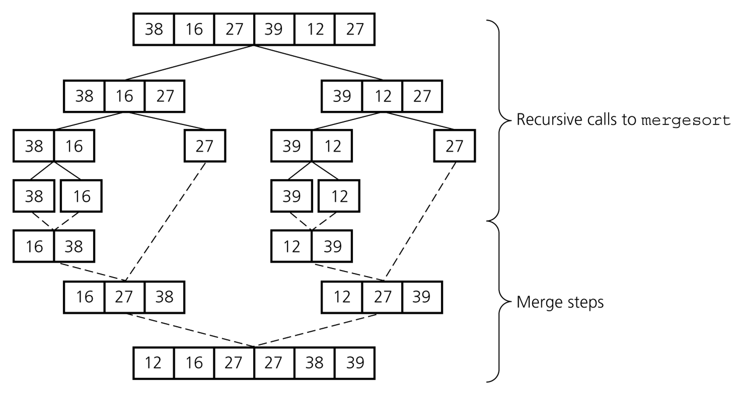
Mergesort – Example2

Slide 40
Merge sort
Merge sort uses extra memory merging two sorted lists
Additional work in copying to the temporary array and back

Slide 41
Computational Complexity
Run time typically depends on:
How many operations there are in each step
How many steps there are

Slide 42
Cost of Merge-Sort
Merge-Sort is a recursive procedure
Represent its running time in the form of a recurrence
Compute recurrence with the help of a recursion tree where
Each node will be a call of Merge-Sort with two children representing sub-problems
Leaf node will represent Merge-Sort call with input size 1. (Boundary condition)
Static computation at each node is running time of Merge procedure.

Slide 43
Merge Sort Analysis
MERGE-SORT A[1 . . n] T(n)
1. If n== 1, done. O(1)
2. Recursively sort A[ 1 ... n/2 ] and 2T(n/2)
A[ n/2+1 ... n ] .
3. “Merge” the 2 sorted lists. O(n)

Slide 44
Running time of Merge Sort
The Running time for Merge Sort is
T(n)= 2T(n/2) + cn for n>1
c for n=1
We can solve this recurrence relation to get the Complexity of Merge Sort
Merge sort has a log-linear time complexity i.e. O(n logn)
Merge Sort
Merging

Slide 45
Insertion Sort
Sorting is actually done in place
Never need the same element in both arrays
Every Insertion costs time penalty
If there are N elements, need to do N insertions
N elements can take nearly N operations to sort
But each operation is very fast
So this is fine if N is small

Slide 46
Merge Sort
Merge sort is stable provided we merge carefully (i.e. it preserves the order of two entries with the same value)
Merge sort is not an in-place algorithm - we need an array of at most size n to do the merging
It is fast

Slide 47
Comparison with Insertion Sort
Insertion-sort is a good choice for small input size and for sequences that are already “almost” sorted.
Merge Sort is an excellent algorithm for situations where the input cannot fit into main memory, but must be stored in blocks on an external memory device, e.g., disks.

Slide 48
Insertion Sort vs Merge Sort
Insertion sort can be faster than merge sort
One array, one operation per step
But N*log(N) eventually beats N² for large N
And once it does, the advantage increases rapidly
O(nlogn)grows more slowly than O(n²)

Slide 49
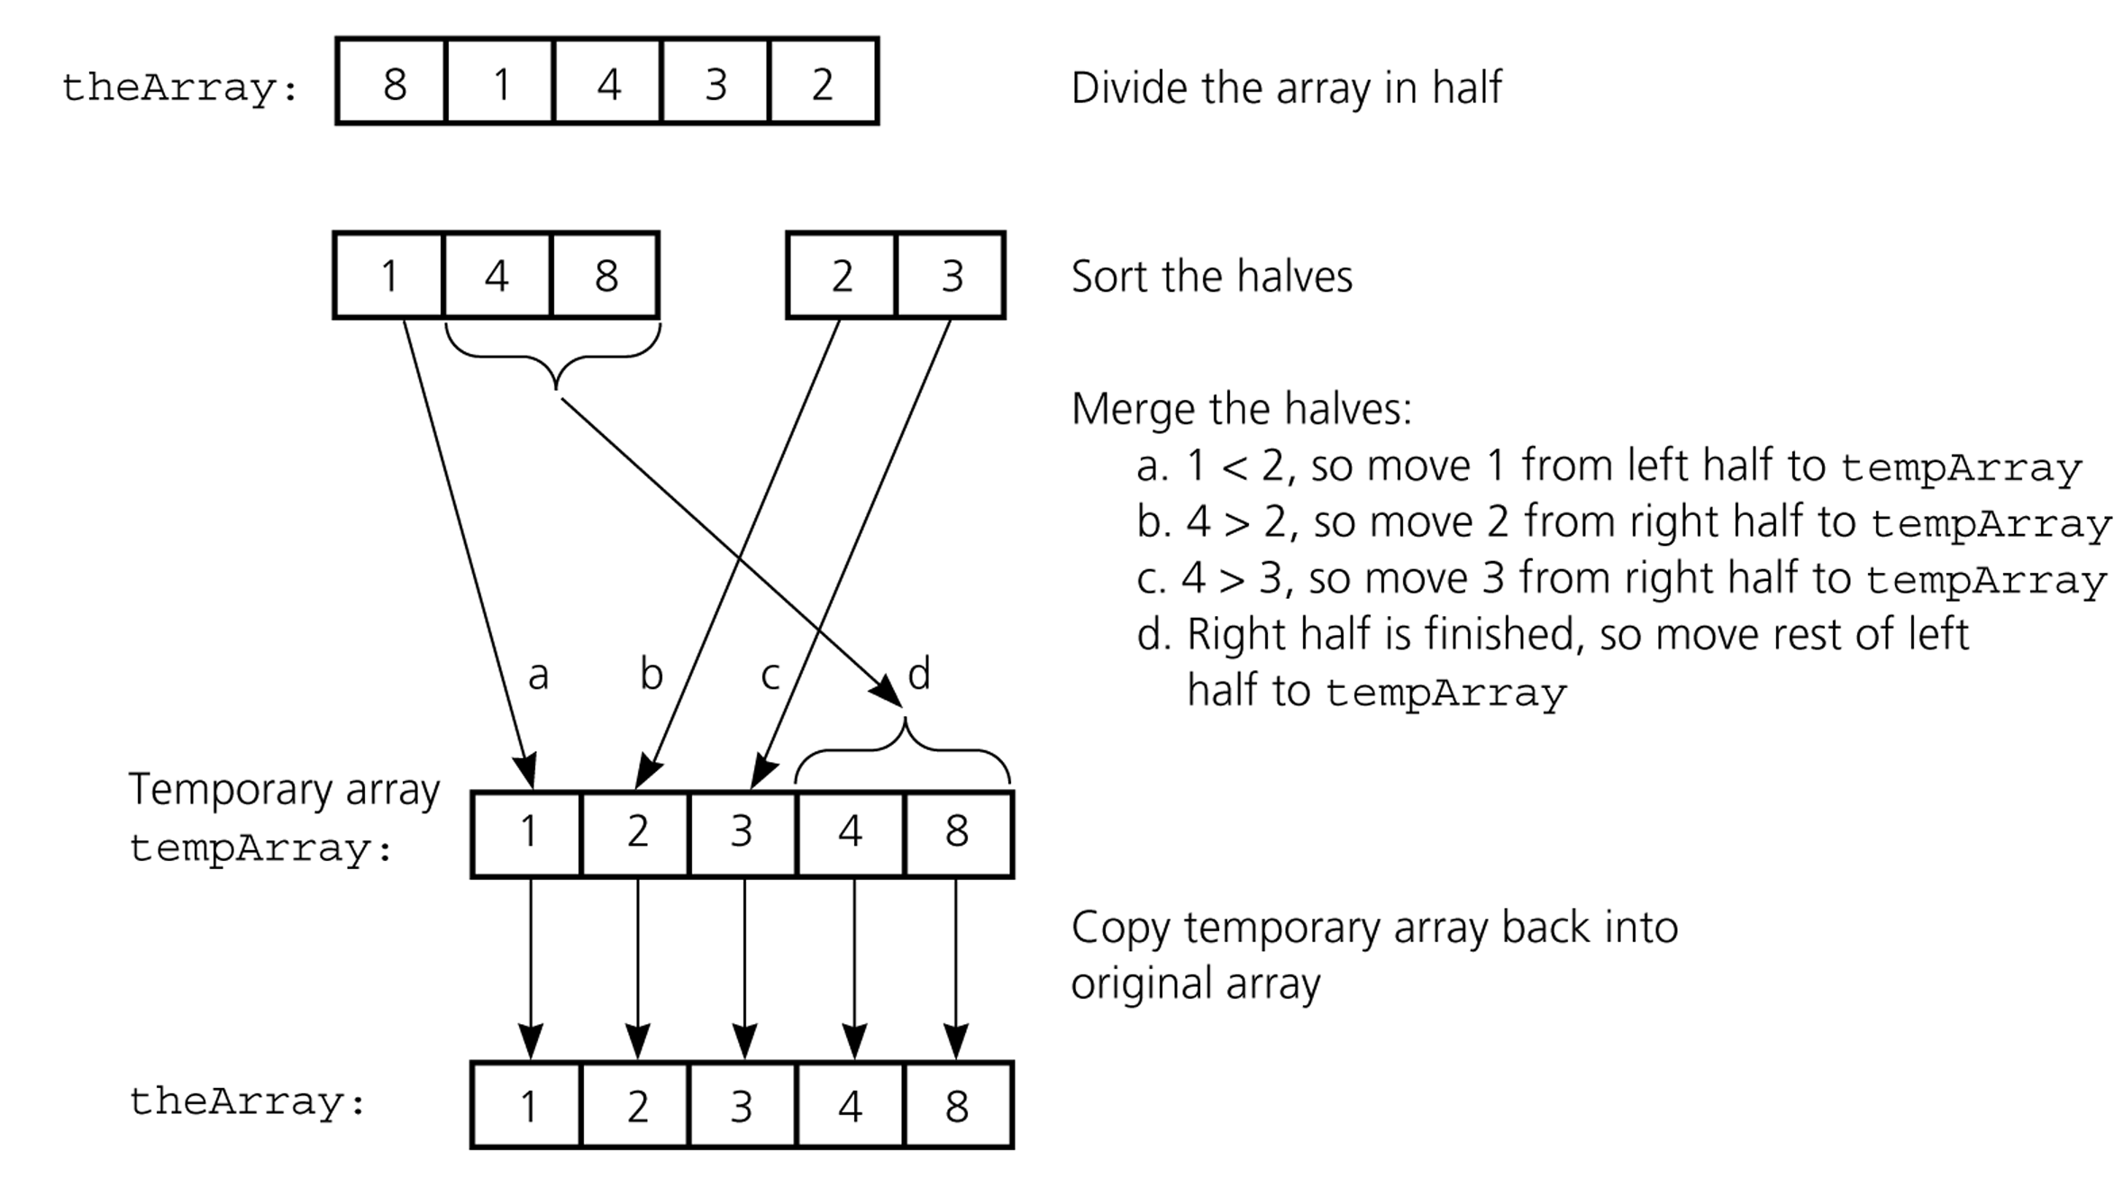
Mergesort - Example

Slide 50
How to Merge
Here are two lists to be merged:
First: (12, 16, 17, 20, 21, 27)
Second: (9, 10, 11, 12, 19)
Compare12 and 9
First: (12, 16, 17, 20, 21, 27)
Second: (10, 11, 12, 19)
New: (9)
Compare 12 and 10
First: (12, 16, 17, 20, 21, 27)
Second: (11, 12, 19)
New: (9, 10)
Compare 12 and 11
First: (12, 16, 17, 20, 21, 27)
Second: (12, 19)
New: (9, 10, 11)
Compare 12 and 12
First: (16, 17, 20, 21, 27)
Second: (12, 19)
New: (9, 10, 11, 12)

Slide 51
Merge Example
Compare 16 and 12
First: (16, 17, 20, 21, 27)
Second: (19)
New: (9, 10, 11, 12, 12)
Compare 16 and 19
First: (17, 20, 21, 27)
Second: (19)
New: (9, 10, 11, 12, 12, 16)
Compare 17 and 19
First: (20, 21, 27)
Second: (19)
New: (9, 10, 11, 12, 12, 16, 17)
Compare 20 and 19
First: (20, 21, 27)
Second: ( )
New: (9, 10, 11, 12, 12, 16, 17, 19)
Checkout 20 and empty list
First: ( )
Second: ( )
New: (9, 10, 11, 12, 12, 16, 17, 19, 20, 21, 27)

Slide 52
MergeSort

